Slide 1
Improving Deep Neural Networks
Deep Learning Specialization Report
Toshiba Software Development (Vietnam) Co., Ltd.
2021-10-05

Slide 2
Contents
01
Practical Aspects of Deep Learning
02
Optimization Algorithms
03
Hyperparameter Tuning, Batch Normalization and Programming Frameworks
04
Questions

Slide 3
Practical Aspects of Deep Learning
01

Slide 4
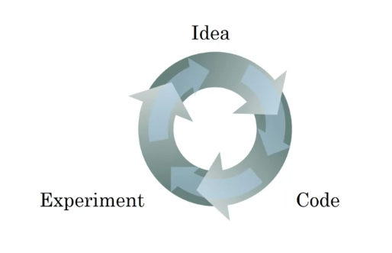
1.1 Train / Dev / Test sets
Applied Machine Learning (ML) is a highly iterative process.
model generalization.
Splitting into train, dev & test sets:
Training sets: to build model.
Dev sets (validation sets): to optimize hyperparameters
Test sets: try & evaluate.
Notes:
Dev & test set from same distribution.
The trend on the ratio of splitting the models:
100 ≤ #datasets ≤ 10^6 => 60%/20%/20%.
#datasets ≥ 10^6 => 98%/1%/1%.
The factors determining ML’s ability:
Make the training error small.
Make the gap between training & test error small.
Notes:
+ Quá trình (process): start idea (identify problems, proposal algorithms, design 1 nn(input, output)) -> implement -> run & experiment get a result tell how well this particular networks or config. Try to find better neural network for application.
=> Goals (stop position): generalization ~ ability to perform well on previously unobserved inputs
+ (?) làm sao để quá trình trên trở lên hiệu quả.
solve: setting dataset can make u more efficient.
3) Why ?
+ same distribution:
+

Slide 5
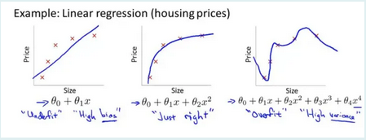
1.2 Bias/Variance (1)
Definition:
Bias: the difference between the average prediction & the correct value.
Variance: the variability of model prediction for a given data point which tells spread of our data.
Problems:
Overfitting: occurs when the gap between the training error & test error is too large.
Underfitting: occurs when the model is not able to obtain a sufficiently low error value on the training set.
The bias variance trade-off: try to find a good balance between bias & variance such that it minimizes the total error:
Notes:
What
+ spread /spét/
+ Bias: sai khac giua t.binh du doan of model & gia tri chinh xac dang co du doan
+ Variance: sự tản mát (co cum/phan tan)
+ high bias -> models not focus training data & oversimplifies the model.
+ high variance -> too focus training data & k mang tinh tong quat
2) Why occur ?
+ capture: catch
+ overfitting: model learn the detail & noise in the training data to extent that it negatively impacts the performance of the model on new data. Model more complexity,
+ underfitting: model too simple.
+ Model’s capacity la kha nang model “fit” nhieu loai functions.
Low capacity -> kho khan fit training data
High capacity -> overfitting ~ ghi nho cac dac trung cua training data ma k hieu qua tren test set.
3) How ?
+ How to fix ?
Giam features
Giam bac cua d.thuc
Giam thieu gia tri theta & giu lai all features

Slide 6
1.2 Bias/Variance (2)
Solving for overfitting:
Cross – validation.
Regularization .
With neural networks: weight decay & dropout.
Notes:
What
+ spread /spét/
+ Bias: sai khac giua t.binh du doan of model & gia tri chinh xac dang co du doan
+ Variance: sự tản mát (co cum/phan tan)
+ high bias -> models not focus training data & oversimplifies the model.
+ high variance -> too focus training data & k mang tinh tong quat
2) Why occur ?
+ capture: catch
+ overfitting: model learn the detail & noise in the training data to extent that it negatively impacts the performance of the model on new data. Model more complexity,
+ underfitting: model too simple.
+ Model’s capacity la kha nang model “fit” nhieu loai functions.
Low capacity -> kho khan fit training data
High capacity -> overfitting ~ ghi nho cac dac trung cua training data ma k hieu qua tren test set.
3) How ?
+ How to fix ?
Giam features
Giam bac cua d.thuc
Giam thieu gia tri theta & giu lai all features

Slide 7
1.3 Basic recipe for machine learning
After having trained an initial model
High bias
1. Try bigger network
2. Train longer
3. Try difference NN architecture
Yes
No
High variance
1. More data
2. Regularization
3. Try difference NN architecture
Yes
Done
Notes:
Recipe: formula
Goal: both low bias & low variane

Slide 8
1.4 Regularizing (1)
Regularizations are techniques used to reduce the error by fitting a function appropriately on the given training set & avoid overfitting.
Techniques:
Modify the loss function
Dropout
Early stopping
Notes:
What:
+ neu k.niem regularizations -> results: simpler models
Reduce the error ?
Avoid overfitting ?
+ mot trong nhung ki thuat regularization pho bien nhat.
- R(): danh gia/anh huong den do phuc tap cua model

Slide 9

1.4 Regularizing: modify the loss function
Add regularization terms:
L1 & L2 regularization:
 | L1 Regularization | L2 Regularization
The penalty term | Square magnitude | Absolute value of magnitude
Notes:
What:
+ Su khac biet chinh giua L1 & L2: the penalty terms
- l1: tong cua toan bo gia tri Tuyet doi cua w
l2: tong cua toan bo can bac 2 cua w
? Why cost function
? Why “the penalty term”

Slide 10
1.4 Regularizing: modify the loss function (2)
Implementation:
Logistic Regression | Neural Networks
Notes:
What
+ Why regularization help reduce overfitting ?

Slide 11



1.4 Regularizing (3)
Regularization for Neural Networks:
Cost function:
The L2 regularization:
The L1 regularization:
Notes:
What:
+ Overfitting:
+ Solves: regularization or more training data.
2) Why using ?
+ regularization: giam so luong models

Slide 12
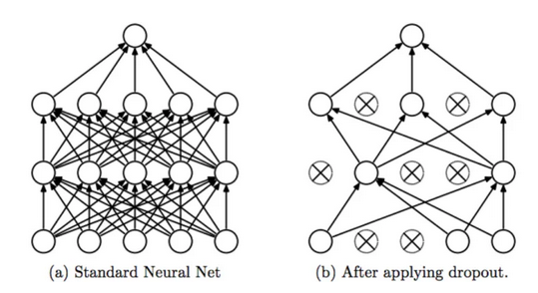
1.4 Regularization: Dropout
Dropout Regularization: remove some neurons/weights on each iteration based on a probability (p%).
=> reduce the neural networks complexity.
Notes:
What
+ trong q.trinh train, moi lan cap nhat he so gradient.d t ngau nhien loai bo p% luong neurons trong layer dang xet.
2) Why ?
+ ly do dropout giup ha

Slide 13
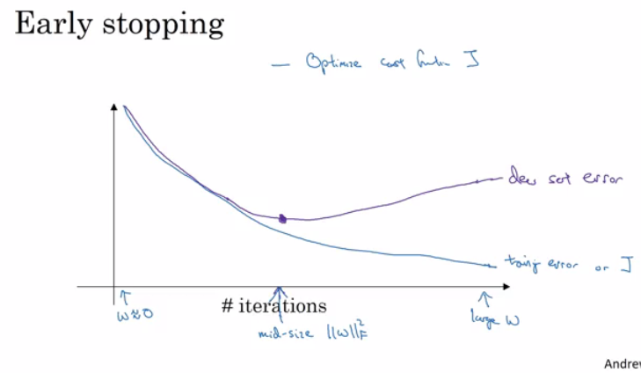
1.4 Regularization: Other methods
Data augmentation:
Get more data.
Example: In computer vision, we can flip, random rotations, random scale …
Early stopping:
At iteration which the dev set cost start increasing.
The stop point at which the lowest training cost & lowest dev cost.
Notes:
What
+ D.A: ki thuat nham tang so luong data.
+ E.S:
- Dung thuat toan trc khi ham mat mat dat gia tri nho nhat ~> tranh overfitting ?
- Diem dung:
- ? Why loss function min ~> overfitting ?

Slide 14
Optimization Algorithms
02
Notes:
+ thao luan cac thuat toan toi uu giup tang toc do train model -> tang toc qua trinh

Slide 15

2.1 Mini-batch Gradient Descent (1)
Vectorization allows us to efficiently compute on m examples. Consider m=5,000,000:
Batch: all datasets
Mini-batch: subsets of datasets.
Example: Batch=5*10^6 ; mini-batches=1000; number of batches = 5000
Mini-batch Gradient Descent:
Run the gradient descent on the mini datasets.
Mini-batch algorithms pseudo code:
XXXX
Notes:
What:
+ vectorization: refers to Single Instruction & Multiple Data (?). Nhung khi large data -> take a huge processing time.
+ gradient descent process:
Initialize start points theta_0.
Update theta (loop) – using all data points
2) Why ?

Slide 16
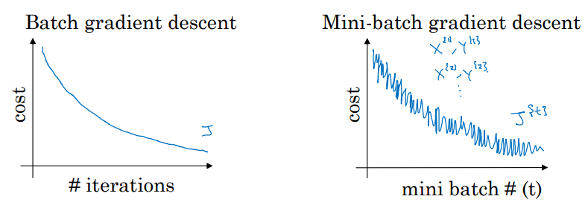
2.1 Mini-batch Gradient Descent (2)
Training with mini batch gradient descent:
Batch GD: expect the cost function (J) to go down on every single iteration.
downwards with a little bit noisier. Mini-batch GD: trend
Choosing mini-batch size, propose number of examples = m:
 | Batch gradient descent | Stochastic gradient descent | Mini-batch gradient descent
Mini-batch size | m | 1 | n, 1 < n < m
 | - Spend more time per iteration - Small training datasets (m< 2000) - Pros: requires a large amount of computer resources with the large training dataset. | The parameters of all the layers are updated after every training sample. | Fastest learning Often, n is a power of 2.
Notes:
What about plot ?
- consider: X{t} & y{t} ~tinh toan~> loss J{t}
2) Why ?
m-b gd nhap nho: tren tat ca cac iteration, model training on a # mini-batch.
3)
+ batch-gradient descent: su dung tt GD tren toan bo cac diem du lieu khi cap nhat trong so
- Slower learning: vi phai
+

Slide 17
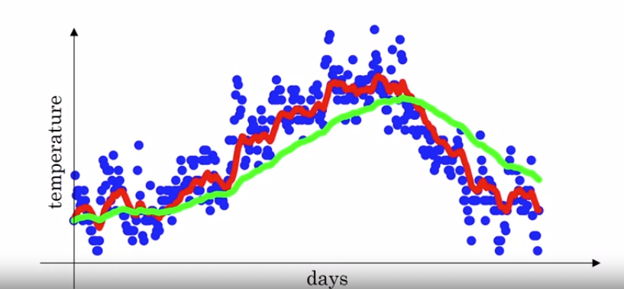
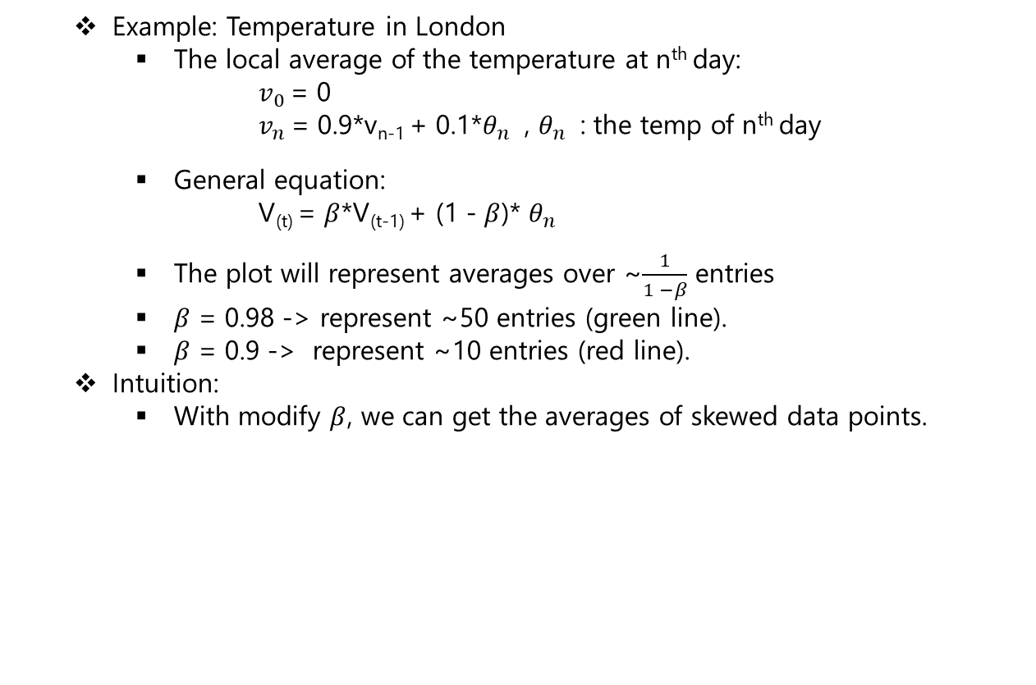
2.2 Exponentially Weighted Averages (1)
Example: Temperature in London
The local average of the temperature at n^{th} day:
$v_{0}$ = 0
$v_{n}$ = 0.9*v_{n-1} + 0.1*$θ_{n}$ , $θ_{n}$ : the temp of n^{th} day
General equation:
V_{(t)} = $β$*V_{(t-1)} + (1 - $β$)* $θ_{n}$
The plot will represent averages over ~$\frac{1}{1 −β}$ entries
$β$ = 0.98 -> represent ~50 entries (green line).
$β$ = 0.9 -> represent ~10 entries (red line).
Intuition:
With modify $β$, we can get the averages of skewed data points.
Notes:
What ?
+ tb co trong so theo cap so nhan
+ Example: phan bo/xu huong nhiet do cac ngay trong nam.
input: nhiet do cac ngay
- output: duong trung binh dong mo ta xu huong nhiet trong nam
? Compute the trends: the local average cua nhiet do
entries: muc/diem
2)
+ lua chon beta, get gia tri trung binh dai dien cho 1 tap diem du lieu.

Slide 18
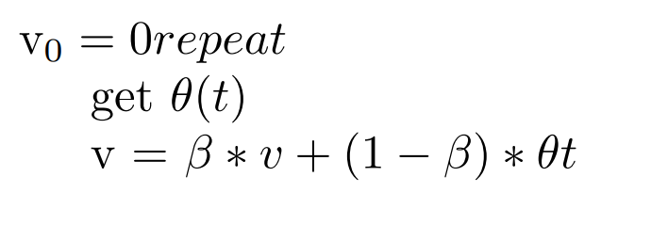
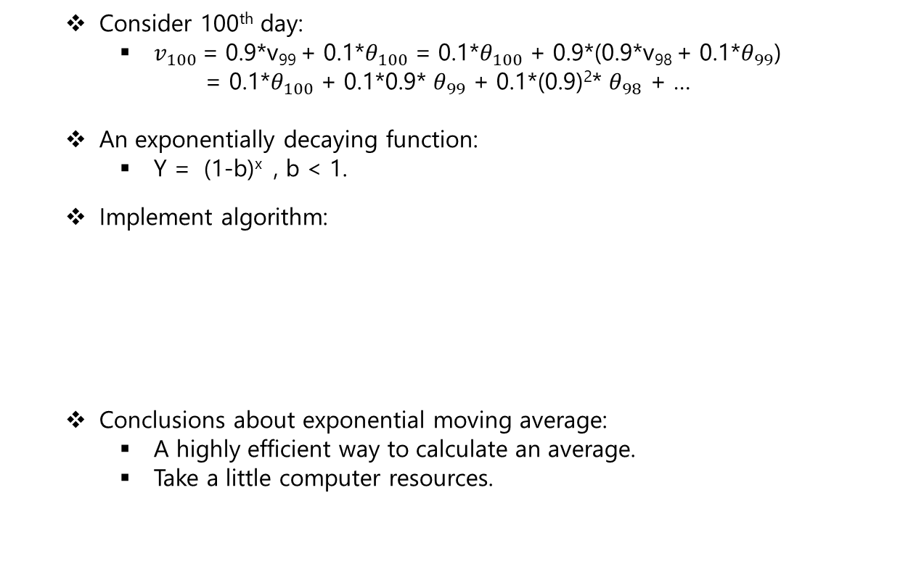
2.2 Exponentially Weighted Averages (2)
Consider 100th day:
$v_{100}$ = 0.9*v₉₉ + 0.1*$θ_{100}$ = 0.1*$θ_{100}$ + 0.9*(0.9*v₉₈ + 0.1*$θ_{99}$)
= 0.1*$θ_{100}$ + 0.1*0.9* $θ_{99}$ + 0.1*(0.9)²* $θ_{98}$ + …
An exponentially decaying function:
Y = (1-b)^{x} , b < 1.
Implement algorithm:
Conclusions about exponential moving average:
A highly efficient way to calculate an average.
Take a little computer resources.
Notes:
What ?
+ tb co trong so theo cap so nhan
+ Example: phan bo/xu huong nhiet do cac ngay trong nam.
input: nhiet do cac ngay
- output: duong trung binh dong mo ta xu huong nhiet trong nam
? Compute the trends: the local average cua nhiet do
entries: muc/diem
2)
+ lua chon beta, get gia tri trung binh dai dien cho 1 tap diem du lieu.

Slide 19
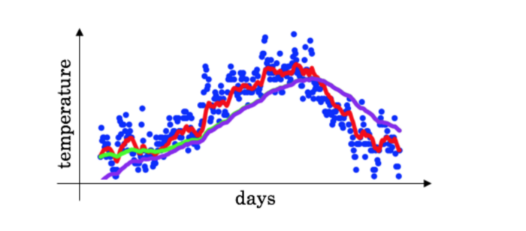
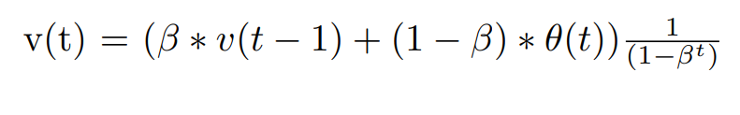
2.3 Bias Correction in Exponentially Weighted Averages
The bias correction helps make the exponentially weighted averages more accurate.
If the curve starts from 0, not many values to average on in the initial days.
If the curve lower than the correct value initially & then take time to moves in line with expected values.
To solve the bias issue:
Notes:
What:
+ Overfitting:
+ Solves: regularization or more training data.
2) Why using ?
+ regularization: giam so luong models

Slide 20
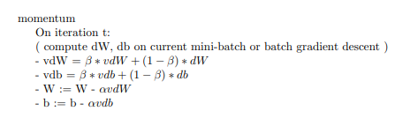
2.4 Gradient Descent with Momentum
Idea: Calculate the exponentially weighted averages for gradients & then update weights with the new values.
Pseudo code:
Momentum helps the cost function to go the minimum point in a more fast & consistent way.
Notes:
What:
+ Overfitting:
+ Solves: regularization or more training data.
2) Why using ?
+ regularization: giam so luong models

Slide 21
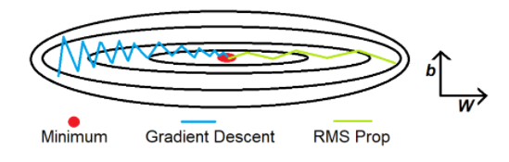
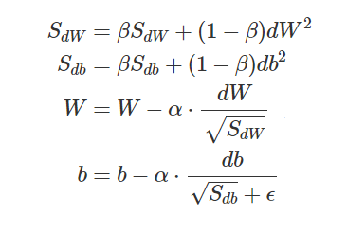
2.5 Root Mean Square Propagation
A technique to dampen out the motion in the bias (b) & speed up gradient descent.
Square the derivatives of both w & b.
Goals: Reduce the large number dW & db.
Pseudo code:
Notes:
What
+ dampen out the motion : giam chuyen dong
Binh Phuong cac dao ham
+ thieu w

Slide 22
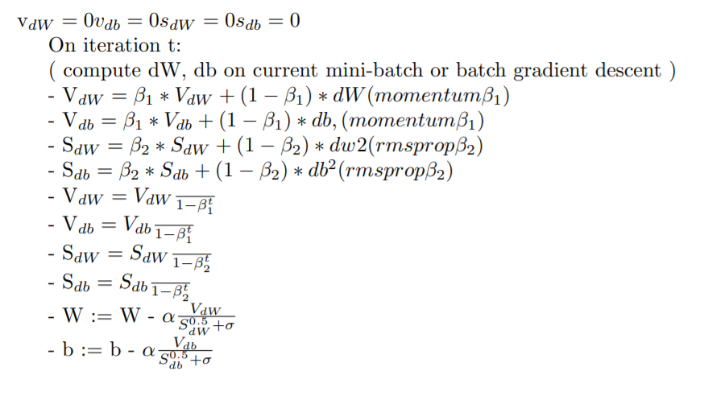
2.6 Adam Optimization Algorithms
Adam optimization simply puts RMS prop & momentum together.
Pseudo code:
Notes:
What:
+ Overfitting:
+ Solves: regularization or more training data.
2) Why using ?
+ regularization: giam so luong models

Slide 23
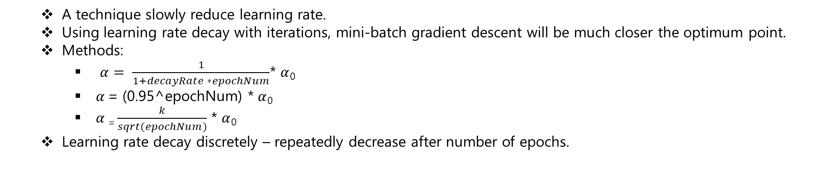
2.7 Learning Rate Decay
A technique slowly reduce learning rate.
Using learning rate decay with iterations, mini-batch gradient descent will be much closer the optimum point.
Methods:
$α= \frac{1}{1+decayRate ∗epochNum}$* $α$₀
$α$ = (0.95^epochNum) * $α$₀
$α$ ₌ $\frac{k}{sqrt(epochNum)}$ * $α$₀
Learning rate decay discretely – repeatedly decrease after number of epochs.
Notes:
What:
+ Overfitting:
+ Solves: regularization or more training data.
2) Why using ?
+ regularization: giam so luong models

Slide 24
Hyperparameter Tuning, Batch Normalization & Programming Frameworks
03
Notes:
+ thao luan cac thuat toan toi uu giup tang toc do train model -> tang toc qua trinh

Slide 25
3.1 Tuning process
Goal: tune model’s hyperparameters to get the best sets.
Hyperparameters:
Learning rate
Momentum beta
Mini-batch size
No. of hidden units
No. of layers
Leaning rate decay
Regularization lambda
Activation functions.
Adam, beta1, beta2 & epsilon.
Notes:
What:
+ Overfitting:
+ Solves: regularization or more training data.
2) Why using ?
+ regularization: giam so luong models

Slide 26
3.2 Using an appropriate scale to pick hyperparameters
Goal: tune model’s hyperparameters to get the best sets.
Hyperparameters:
Learning rate
Momentum beta
Mini-batch size
No. of hidden units
No. of layers
Leaning rate decay
Regularization lambda
Activation functions.
Adam, beta1, beta2 & epsilon.
Notes:
What:
+ Overfitting:
+ Solves: regularization or more training data.
2) Why using ?
+ regularization: giam so luong models

Slide 27
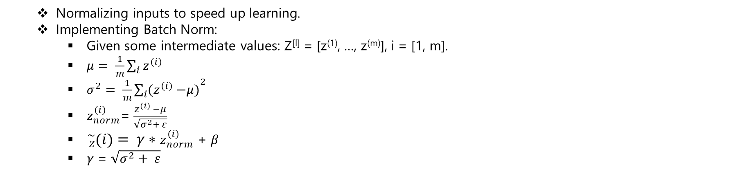
3.3 Batch Normalization: Normalizing activations in a Network
Normalizing inputs to speed up learning.
Implementing Batch Norm:
Given some intermediate values: Z^{[l]} = [z⁽¹⁾, …, z^{(m)}], i = [1, m].
$μ= \frac{1}{m}\sum_{i}{z^{(i)}}$
$σ^{2}= \frac{1}{m}{\sum_{i}{{(z}^{(i)} −μ)}}^{2}$
$z_{norm}^{(i)}$= $\frac{z^{(i)} −μ}{\sqrt{σ^{2}+ ε}}$
${}_{Z}^{\sim }{\left(i\right)= γ∗}$ $z_{norm}^{(i)}$ + $β$
$γ$ = $\sqrt{σ^{2}+ ε}$
Notes:
What:
+ Overfitting:
+ Solves: regularization or more training data.
2) Why using ?
+ regularization: giam so luong models

Slide 28
3.3 Batch Normalization: Fitting batch normalization into a NN
Normalizing inputs to speed up learning.
Implementing Batch Norm:
Given some intermediate values: Z^{[l]} = [z⁽¹⁾, …, z^{(m)}], i = [1, m].
$μ= \frac{1}{m}\sum_{i}{z^{(i)}}$
$σ^{2}= \frac{1}{m}{\sum_{i}{{(z}^{(i)} −μ)}}^{2}$
$z_{norm}^{(i)}$= $\frac{z^{(i)} −μ}{\sqrt{σ^{2}+ ε}}$
${}_{Z}^{\sim }{\left(i\right)= γ∗}$ $z_{norm}^{(i)}$ + $β$
$γ$ = $\sqrt{σ^{2}+ ε}$
Notes:
What:
+ Overfitting:
+ Solves: regularization or more training data.
2) Why using ?
+ regularization: giam so luong models

Slide 29
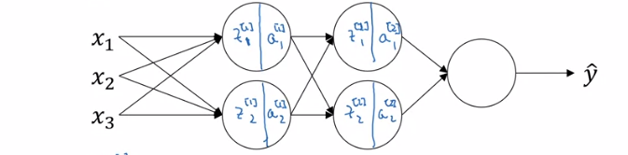

3.3 Batch Normalization: Why does batch normalization work ?
Fitting batch normalization into a neural network
Consider 3 hidden layers NN.
NN parameters: W^{[1]}, b^{[1]}, W^{[2]}, b^{[2]}, beta^{[1]}, alpha^{[1]}, beta^{[2]}, alpha^{[2]}
Shapes:
beta^{[l]}, z^{[l]}, gamma^{[l]} – (n^{[l]}, m)
Why dose batch normalization work ?
Normalize X
Batch normalization reduces the problem of input values changing.
Notes:
What:
+ Overfitting:
+ Solves: regularization or more training data.
2) Why using ?
+ regularization: giam so luong models

Slide 30
Thank you

